Slide 1

STARK AIR
We Go Above And Beyond…

Slide 2
TEAM INFORMATION
K Roja(Team Lead)
Two-way Flight
Flight Search
Flight Select
Booking & Cancellation
Nishan Bhowmick
Otp Generation & Validation
Password Updation
Registration
Booking & Cancellation
Siddharth Singh
Seat Matrix
Front End Validation
User & Admin Grid
Booking & Cancellation
Mukul Katiyar
User Login
Admin Login
Email & Ticket Generation
Booking & Cancellation

Slide 3
PROBLEM STATEMENT
Stark Air is a one-stop-shop for all your flying needs coupled with an impeccable user-friendly interface. From browsing every flight fitting your travel criteria and needs, right down to even cancelling a booking no questions asked, we pay special attention to the customer's ease and comfort. Time is money and Stark Air takes that very seriously, making sure to provide our customers with a hassle-free, prompt flight-booking experience from the comfort of their homes.

Slide 4
OBJECTIVES
To ensure a smooth and user-friendly flight-booking experience.
To provide users with exclusive services such as customized seat booking, extensive search, easy-breezy booking cancellations and much more.

Slide 5
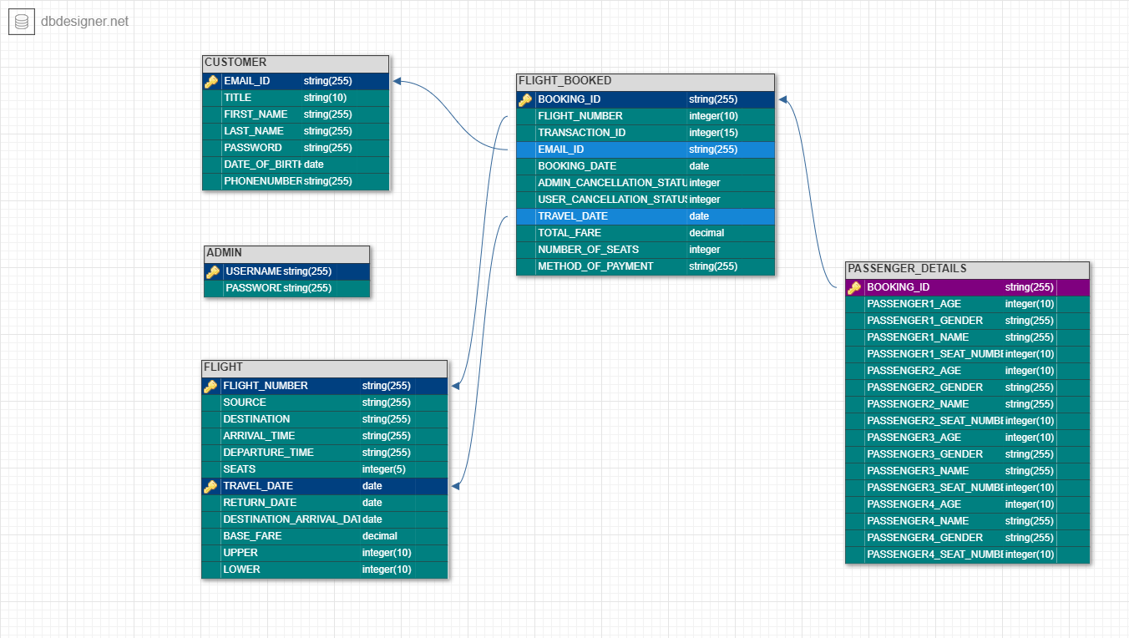
DATABASE STRUCTURE

Slide 6
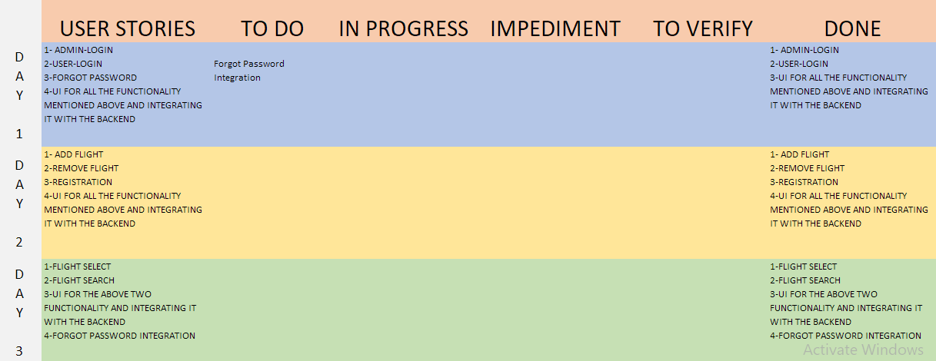
SCRUM TABLE
SPRINT 1

Slide 7
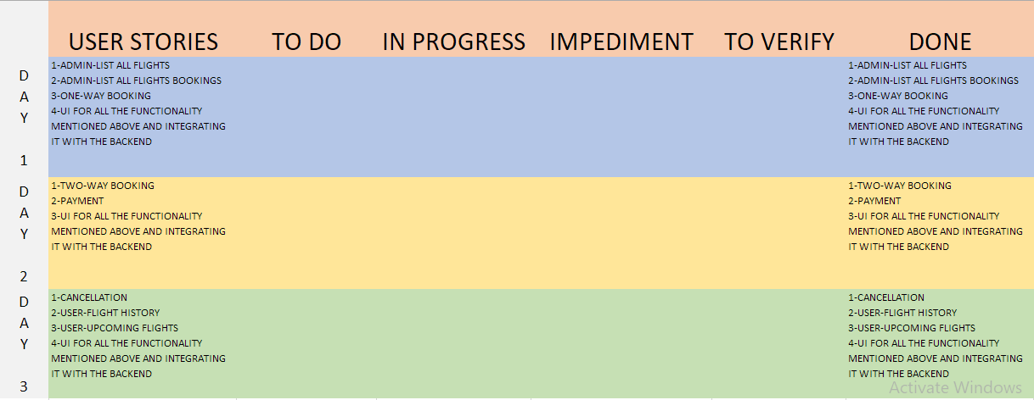
SCRUM TABLE
SPRINT 2

Slide 8
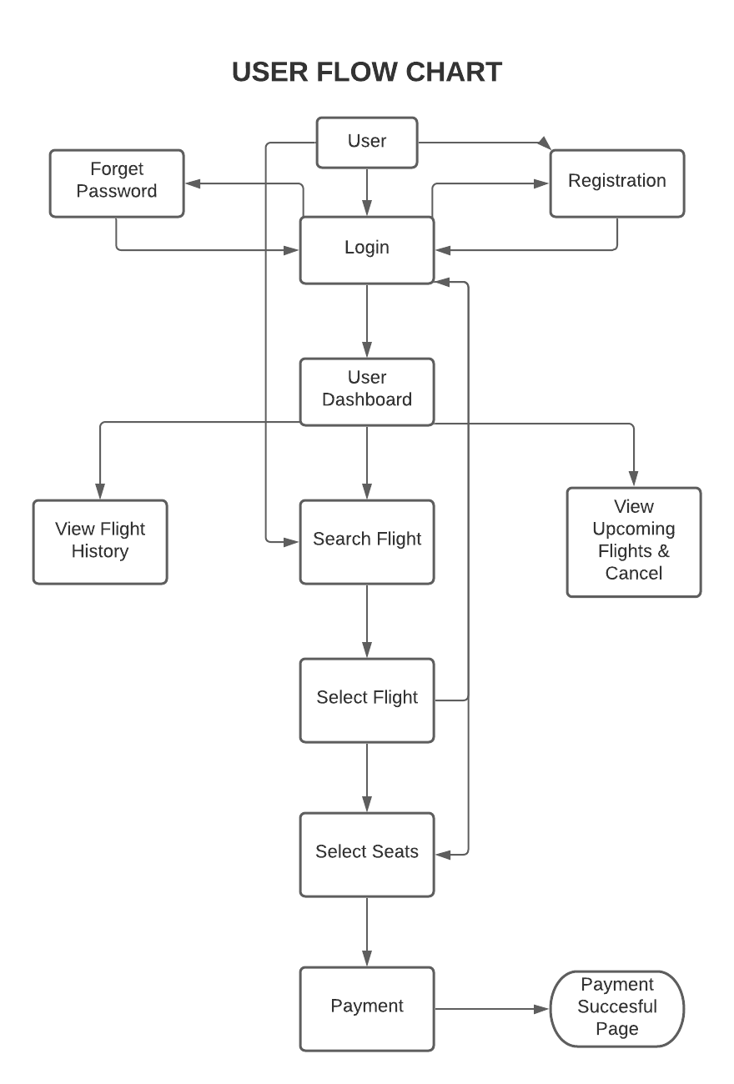
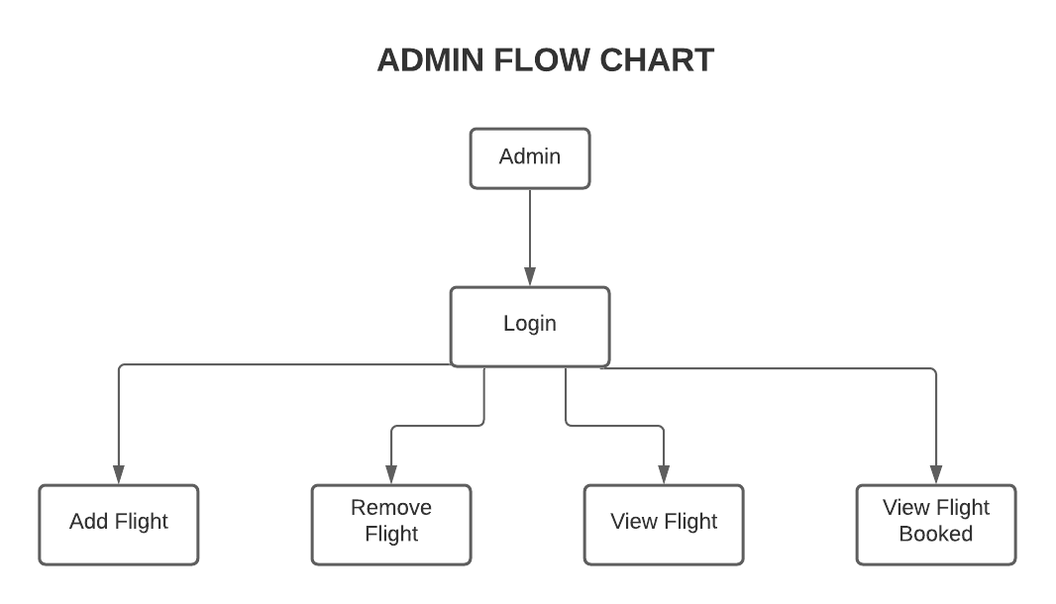
FLOW CHART OF THE PROJECT

Slide 9
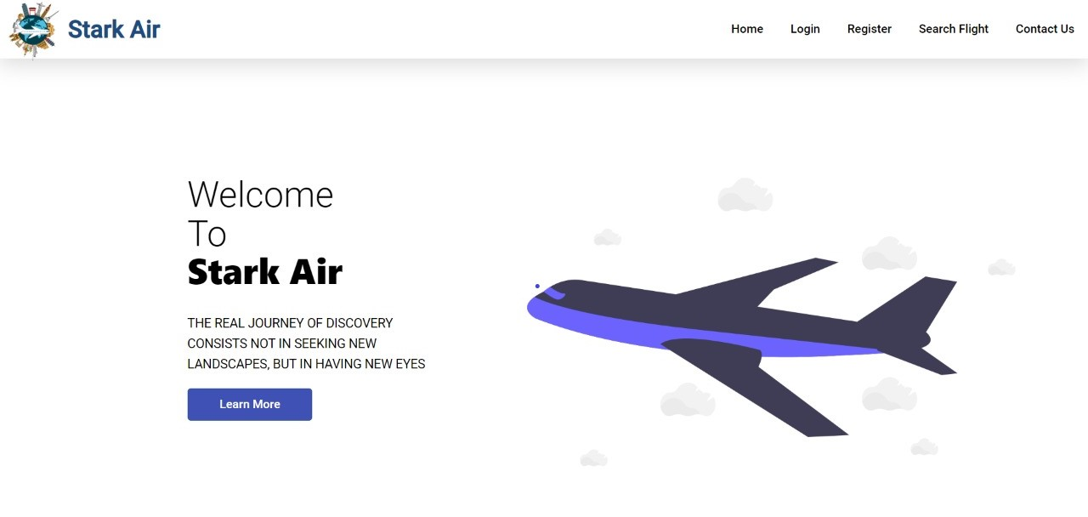
GLIMPSE OF THE PROJECT

Slide 10
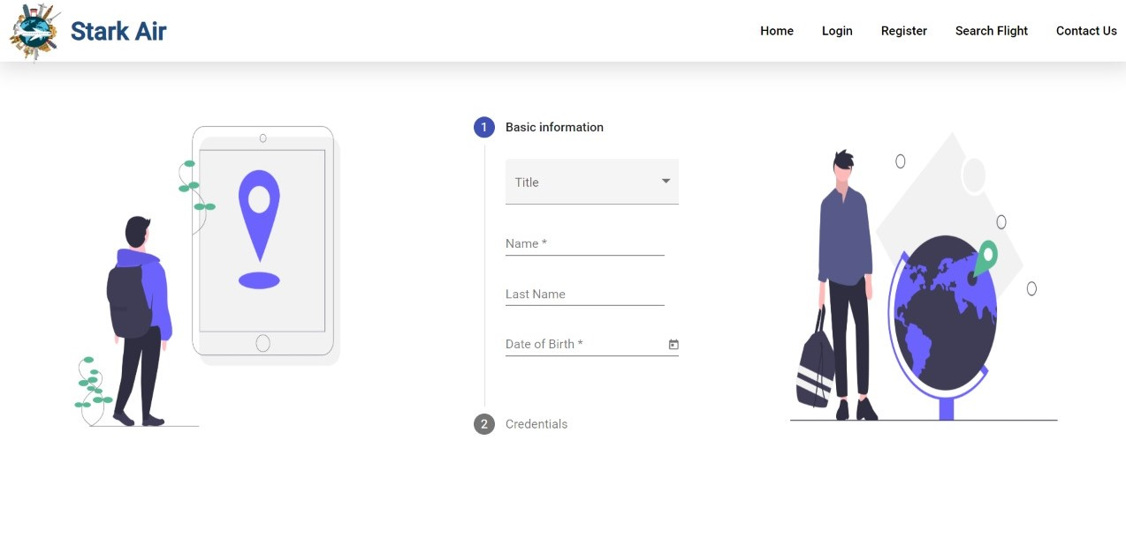
GLIMPSE OF THE PROJECT

Slide 11
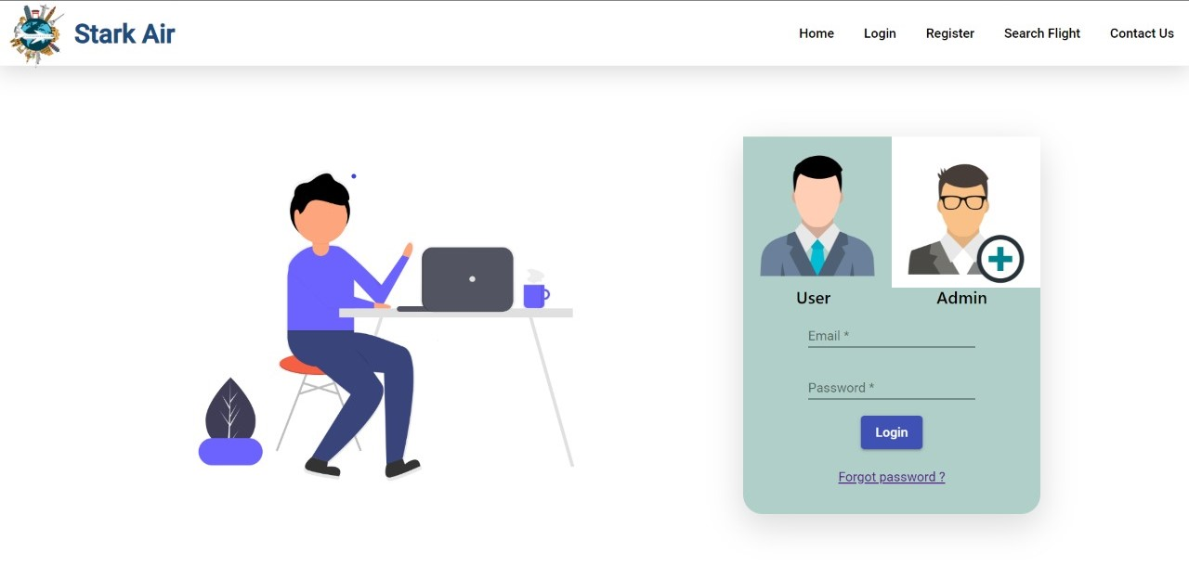
GLIMPSE OF THE PROJECT

Slide 12
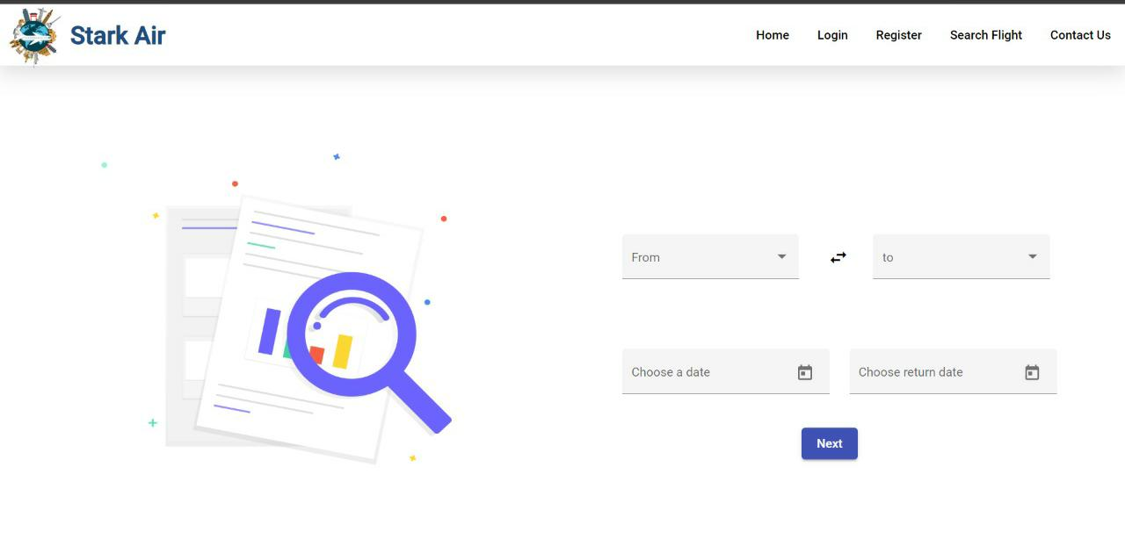
GLIMPSE OF THE PROJECT

Slide 13
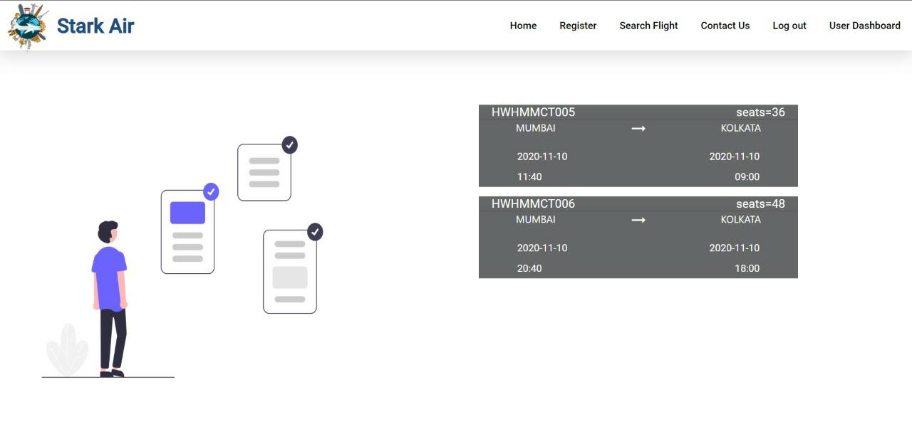
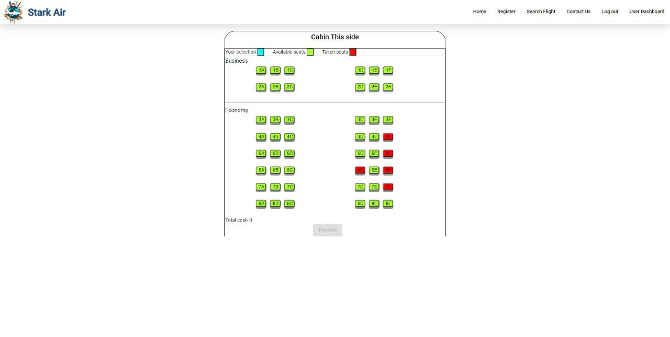
GLIMPSE OF THE PROJECT

Slide 14
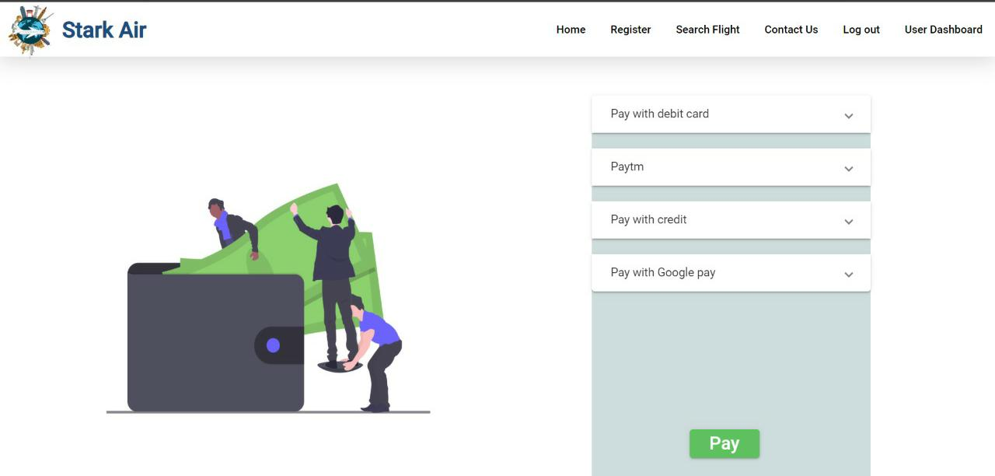
GLIMPSE OF THE PROJECT

Slide 15
CONCLUSION
The project will enable a user to experience an unparalleled smooth-sailing flight booking process with various exclusive experiences at their beck and call, all from the comfort of their homes. It would act as the perfect mediator between a customer and airline companies, bringing home a multitude of features specifically crafted to keep the users' best interest at mind.

